Slide 1

Note: The data and information in this document is reflective of a hypothetical situation and client. This document is to be used for KPMG Virtual Internship purposes only.
Sprocket Central Pty Ltd
Data analytics approach

Slide 2
Note: The data and information in this document is reflective of a hypothetical situation and client. This document is to be used for KPMG Virtual Internship purposes only.
Agenda
Introduction
Data Exploration
Model Development

Slide 3
Note: The data and information in this document is reflective of a hypothetical situation and client. This document is to be used for KPMG Virtual Internship purposes only.
Introduction
The customers of given data by certain Features:
The Main features used are:
Tenure
Past 3 Years Purchase History
The grouping done by:
State they live
Their economic status
Job Roles
Genders
Brand

Slide 4
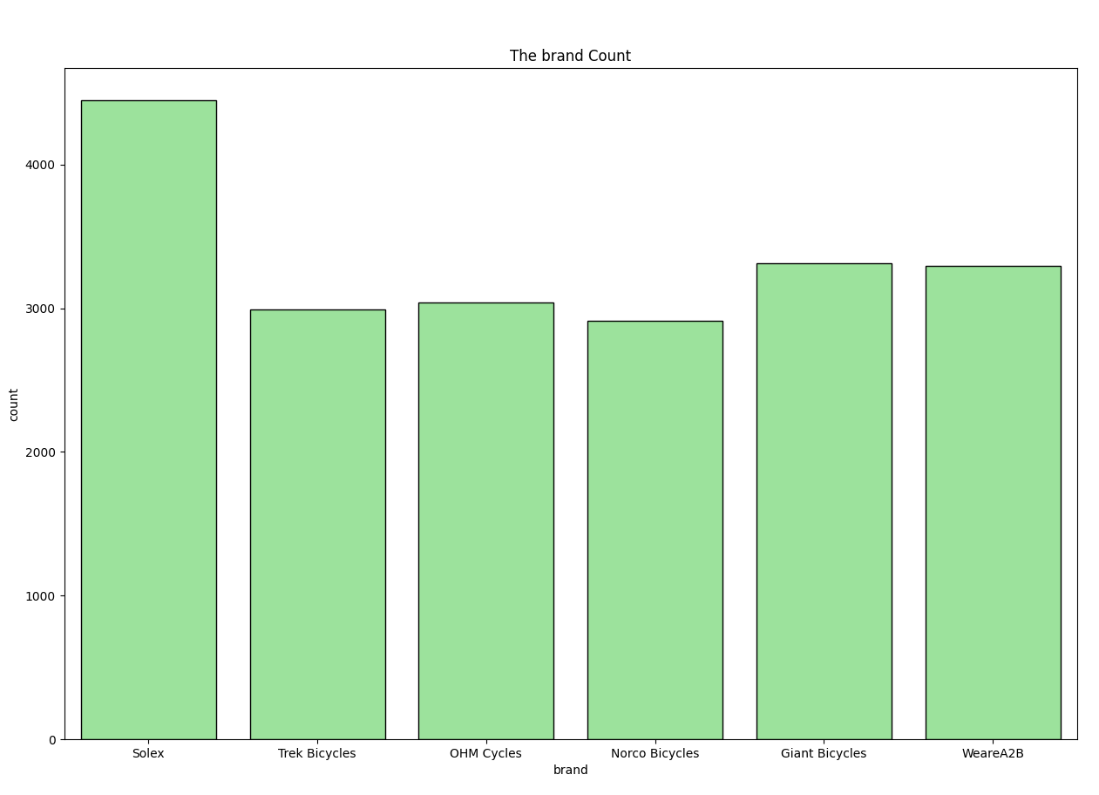
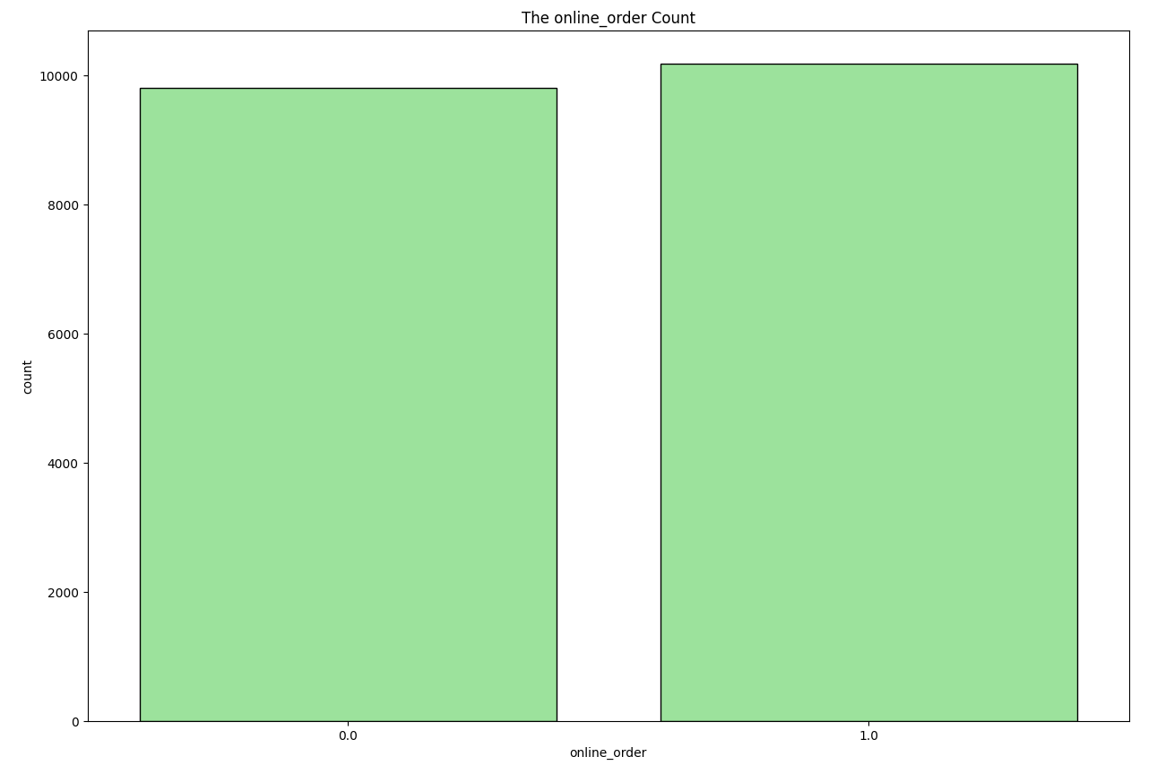
Note: The data and information in this document is reflective of a hypothetical situation and client. This document is to be used for KPMG Virtual Internship purposes only.
Data Exploration
By the type of features customers expect:
The most opted brand is Solex is the highest, Giant Bicycles and WeareA2B.
The offline and online orders are equal counts.

Slide 5
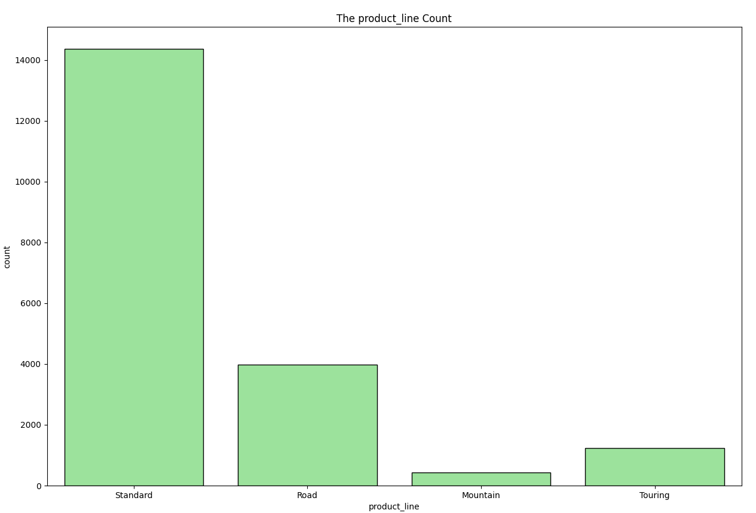
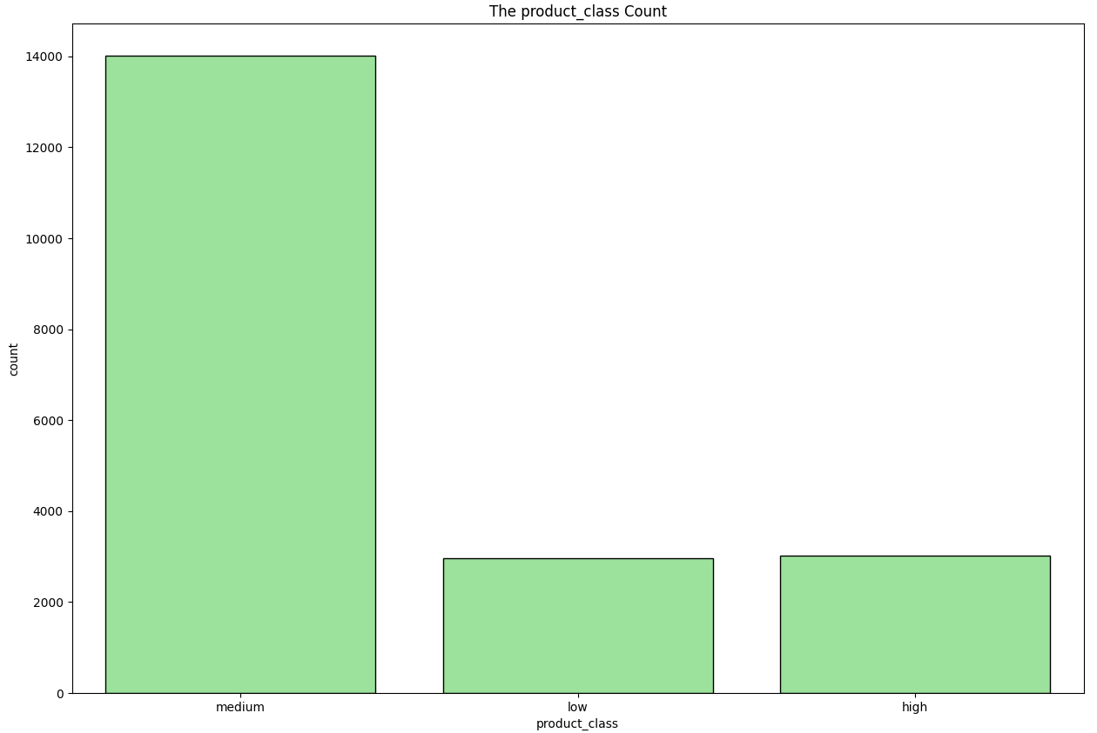
Note: The data and information in this document is reflective of a hypothetical situation and client. This document is to be used for KPMG Virtual Internship purposes only.
Data Exploration
By the type of features customers expect:
The Standard Type is the most preferred type of cycles.
The Medium Class is the most opted by the customer.

Slide 6
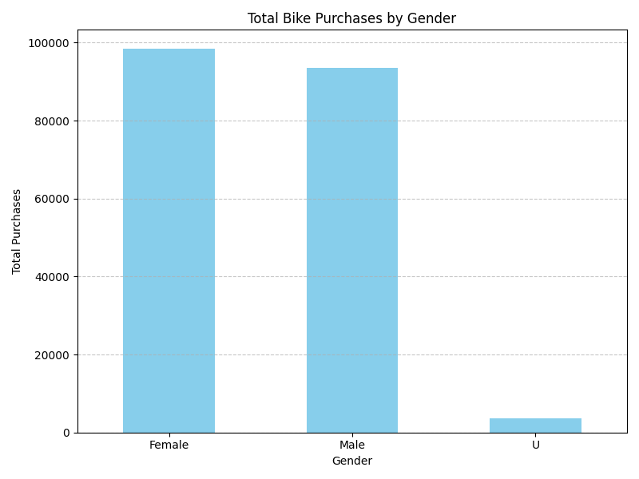
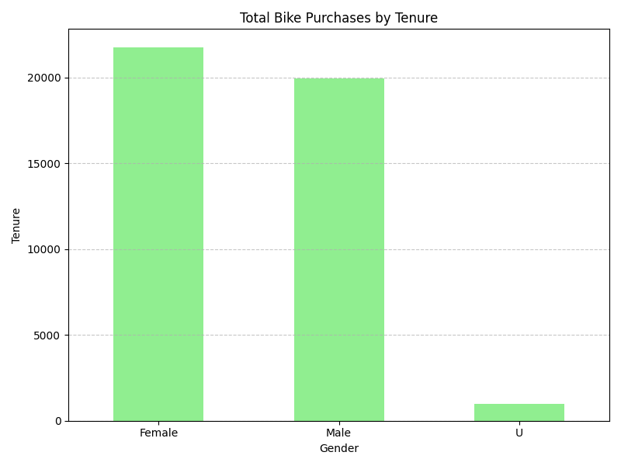
Note: The data and information in this document is reflective of a hypothetical situation and client. This document is to be used for KPMG Virtual Internship purposes only.
Data Exploration
By the type of customers who are interested based on Gender:
The Female customers have a slightly higher purchases and tenure usage

Slide 7
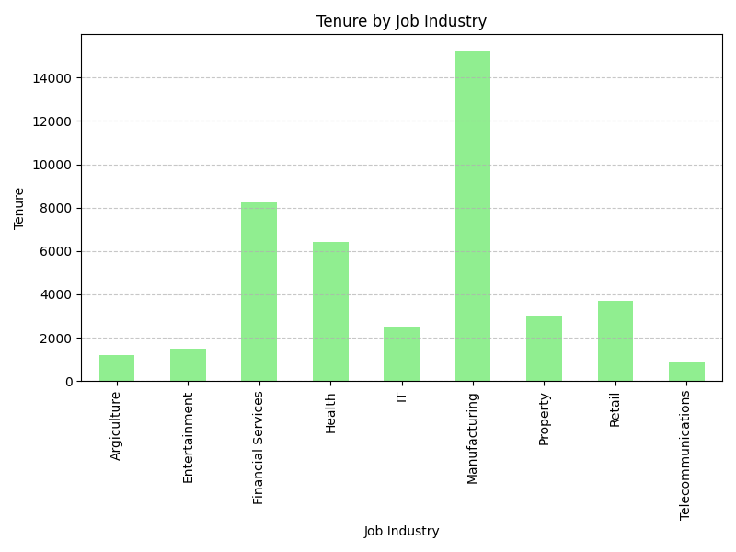
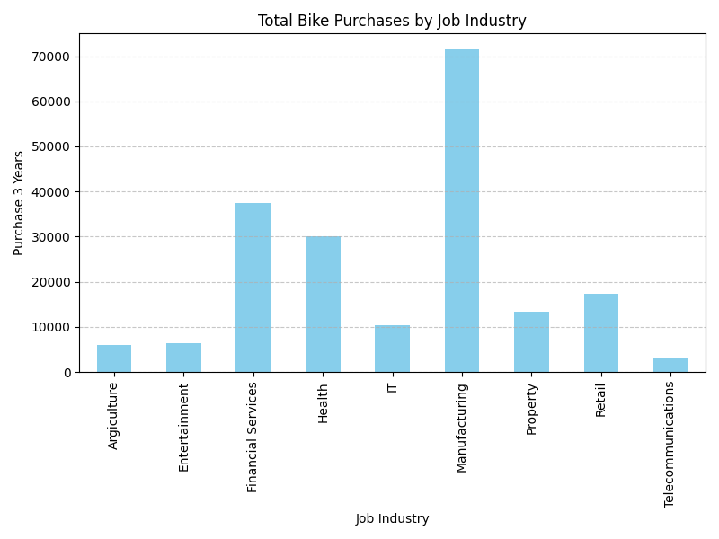
Note: The data and information in this document is reflective of a hypothetical situation and client. This document is to be used for KPMG Virtual Internship purposes only.
Data Exploration
By the type of customers who are interested based on Job Titles:
The people from Manufacturing sector are preferring more bikes.

Slide 8
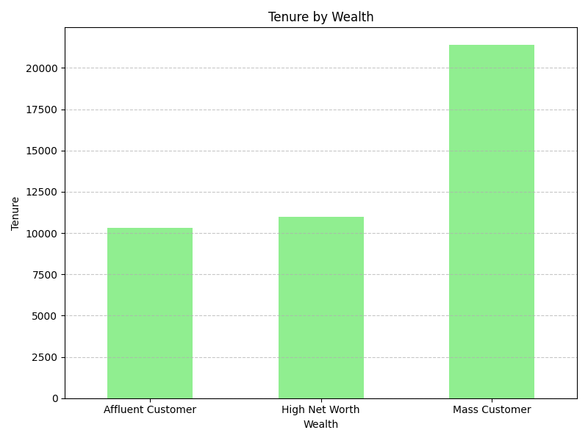
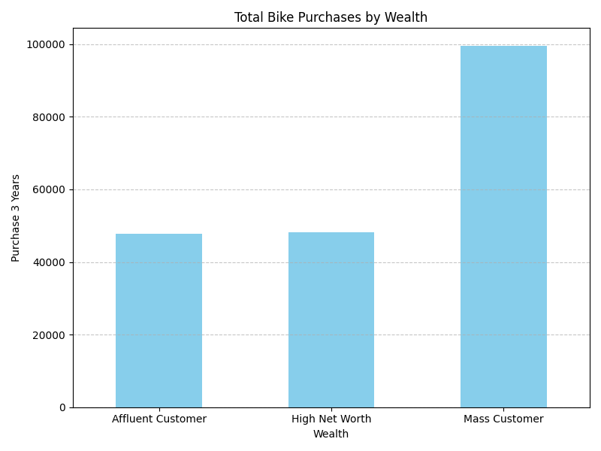
Note: The data and information in this document is reflective of a hypothetical situation and client. This document is to be used for KPMG Virtual Internship purposes only.
Data Exploration
By the type of customers who are interested based on Wealth:
The Mass customers are highly preferring cycles.

Slide 9
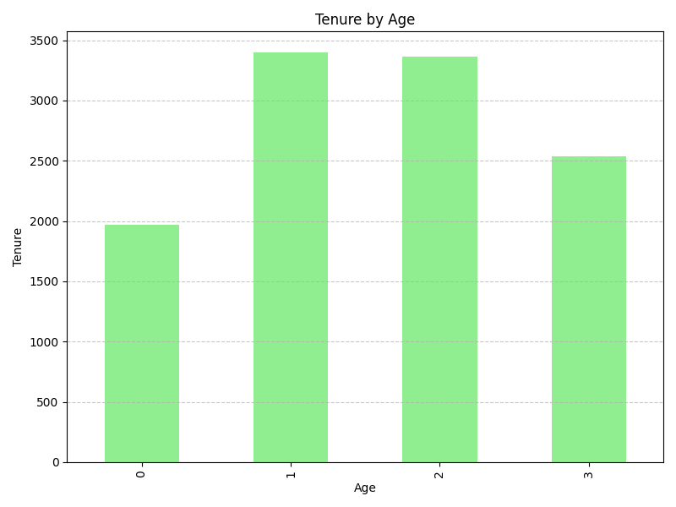
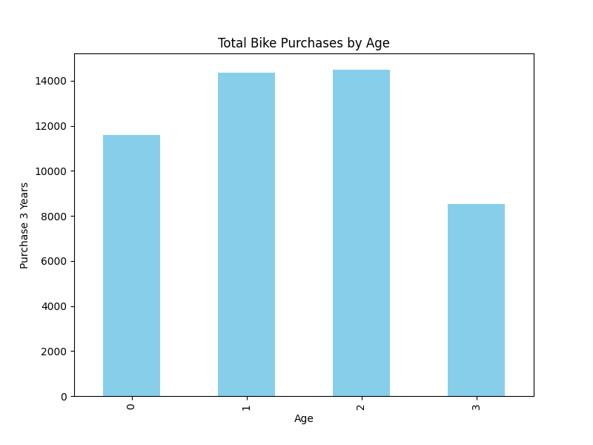
Note: The data and information in this document is reflective of a hypothetical situation and client. This document is to be used for KPMG Virtual Internship purposes only.
Data Exploration
By the type of customers who are interested based on Age:
The Customers between 37-53 and 53-69 are highly preferring cycles.

Slide 10
Note: The data and information in this document is reflective of a hypothetical situation and client. This document is to be used for KPMG Virtual Internship purposes only.
Model Development
The main outcomes of the most preferred customers:
The Female customers have a slightly higher purchases and tenure usage in terms of gender
The people from Manufacturing sector are preferring more bikes in terms of job roles.
The Mass customers are highly preferring cycles in terms of wealth of the customers.
The Customers between 37-53 and 53-69 are highly preferring cycles in terms of Age.

Slide 11
Note: The data and information in this document is reflective of a hypothetical situation and client. This document is to be used for KPMG Virtual Internship purposes only.
Thank You

